Slide 1
Schedule Production:
An Overview
Provided by:
Instructional Support Services
Mia McClellan, Dean
Brian Ebalo, Supervisor
Shirley Bouless, Instructional Services Specialist
Viridiana Coronel, Instructional Services Specialist
Jessie Reyes, Instructional Services Specialist
PJ Concha, Instructional Services Specialist

Slide 2
Agenda

Slide 3
Training: Purpose & Outcome

Slide 4
Schools & Centers: Responsibilities
Dean and Department Chairs
  Compare class offering from previous term.
  Plan and manage course sections and establish proper meeting information.
  Work with department leads to ensure proper class days/times.
  Identify faculty to staff course sections.
Administrative Support
  Work with Dean and Chairs to verify the accuracy of the CSC forms and complete proto fields.
  Manage classroom availability.
  Enter faculty names in FASC (verify section meeting information).
  Submit CSC workbooks inclusive of all disciplines within the school/center in one email to SWCISSScheduling@swccd.edu
Dean
  Certify to ensure accuracy and completion of proto for each phase of schedule production (Phases, I, II, and III).

Slide 5
Timeline:
Summer & Fall 2021

Slide 6
Timeline: Summer 2021
PHASE 1
PHASE 2
PHASE 3
FINAL
November 30–January 15
Proto Available
November 30
Schools AND Centers begin building the Summer 2021 Schedule
February 1–February 16
Deans/Chairs Review
February 1
Deans/ Chairs Review Proto distributed by ISS
February 16, 2021
Deans/ Chairs Review Proof due by
4:30 pm to ISS
February 17-March 1
ISS updates Colleague
March 15
Final Class Schedule provided to Community Relations
Schedule Available
March 19
Schedule Available online
April 26
Registration Begins
1
December 11, 2021
Centers send GE courses to ISS for input
January 8, 2021
ISS sends notification to Centers and Schools of update
January 15, 2021
Protos due to ISS
2
3
✓

Slide 7
Timeline: Fall 2021
PHASE 1
PHASE 2
PHASE 3
FINAL
December 4–December 18
Proto Available
December 4
Schools AND Centers begin building the Fall 2021 Schedule
February 22–March 12
Deans/Chairs Review
February 22
Deans/ Chairs Review Proto distributed by ISS
March 12
Deans/ Chairs Review Proof due by
4:30 pm to ISS
March 26–April 16
Final Review
March 26
Final Review distributed by ISS
April 16
Final Review due to ISS by 4:30 pm
Schedule Available
May 10
Schedule Available online
June 14
Registration Begins
1
December 18
Centers send GE courses to ISS for input
Janruary 15
ISS sends notification to Centers and Schools of update
January 29
Protos due to ISS
2
3
✓

Slide 8

Phase I: Proto Available
First (initial) run of the proto; also known as the Rollover
There are many elements which are critical to the completion of the class schedule. Each column has a purpose in creating and defining the elements needed.
Access initial rollover via Business Objects
85% of adds, modifications and cancellation of sections to be submitted in CSC workbook.

Slide 9
Phase II:
Deans & Chairs Review
✓ Access Deans & Chairs Review proof via Business Objects
✓ Review your submitted changes
✓ Last opportunity to add or modify class sections without permission (this stage of schedule production should contain approximately 15% of the remaining completed schedule).
✓ Complete and submit PHASE II course section changes on CSC workbook to SWCISSScheduling@swccd.edu
2

Slide 10
Phase III: Final Review
Review for minor edits only. At this stage of schedule production, requests such as; class additions, modification, room changes etc., should not be necessary.
Exceptions must be approved by the Dean of Instructional Support Services.
Attach your final review with signature page and submit to SWCISSScheduling@swccd.edu.
3

Slide 11
Business Objects Proto and Course Section:
Excel Workbook
Source/Action | Rptg Sch | Dept | Sect Status | Reg Code Synonym | Course Name | Sect Nbr | Pri Flag | Cross-Listed Sections | Capacity |  | Waitlist Allowances |  | Faculty Consent Flag | Location
 |  |  |  |  |  |  |  |  | Sect | Global | Flag | Max |  | Site | Bldg | Room | Cap
Proto | B | SSM | A | 607341 | AFRO-110 | 01 | Y | AFRO-110-01, HIST- 110-01 | 45 | 45 | Y |  | N | MC | 470 | 473 | 48
Proto | B | SSM | A | 607342 | AFRO-111 | 01 | Y | AFRO-111-01, HIST- 111-01 | 45 | 45 | Y |  | N | MC | 470 | 473 | 48
Proto | B | SSM | A | 607343 | AFRO-111 | 03 | Y | AFRO-111-03, HIST- 111-03 | 45 | 45 | Y |  | N | MC | 470 | 473 | 48
Proto | B | SSM | A | 607344 | AFRO-151 | 01 | Y | AFRO-151-01, SOC- 151-01 | 45 | 45 | Y |  | N | MC | 470 | 473 | 48
Sect Fin Acct Meth | Sect Contact Meas | Sect Contact Hrs | Load | Start Date | End Date | Instr Metho d | Meeting Days | Start Time | End Time | No of Weeks | Section Printed Comm | Assigned Faculty
W | W | 3.4 | 3.00 | 01/28/19 | 05/24/19 | LEC | MW | 8:35 AM | 10:00 AM | 16 |  | S. James
W | W | 3.4 | 3.00 | 01/28/19 | 05/24/19 | LEC | TTh | 10:10 AM | 11:35 AM | 16 |  | S. James
W | W | 3.4 | 3.00 | 01/28/19 | 05/24/19 | LEC | MW | 10:10 AM | 11:35 AM | 16 |  | S. James
W | W | 3.4 | 3.00 | 01/28/19 | 05/24/19 | LEC | MW | 11:45 AM | 1:10 PM | 16 |  | S. James

Slide 12
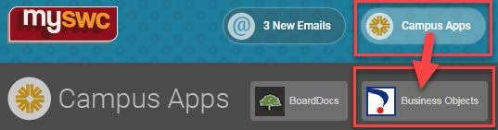
Process Notes for First Generation Digital Proto Modifications
Note: Deans, Chairs, and Admin Assistant should already have access to BusinessObjects and the Ad Hoc Managerial Reports folder. If you do not have access granted to you, you won’t be able to do this.
1. Enter BusinessObjects by signing into my.swccd.edu and clicking the BusinessObjects tile in the Campus Apps area. If you don’t see the tile, you do not have access. Sign in again with your regular name and password in the pop-up that appears.
2. Follow this path by clicking: (A) the Documents tab at the top of the page, (B) Folders, (C) Ad Hoc Managerial Reports, and finally (D) Scheduling-ISS Reports.

Slide 13
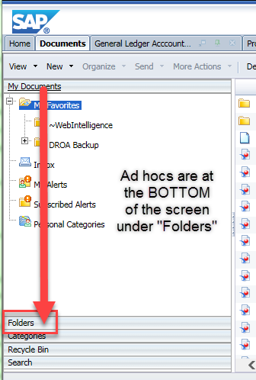
3. When looking for Ad Hoc, scroll all the way to the bottom of the screen to find the tab marked “Folders” click on that to open the public folders, including Ad Hocs.

Slide 14
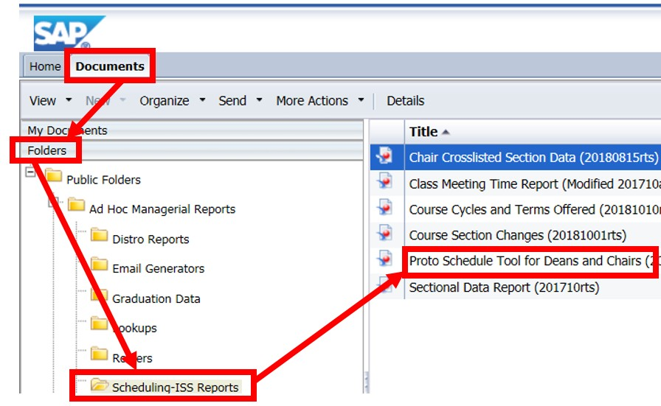
4. From there you will see the report titled: Proto Schedule Tool for Deans and Chairs, click that

Slide 15
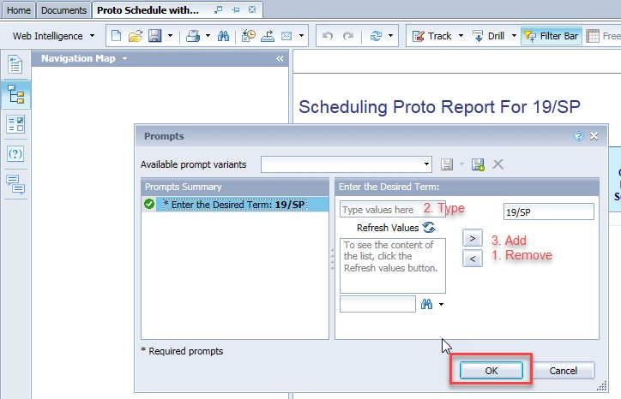
5. The first thing you will see will be a pop-up asking you what term you wish to use. If you need a term other than 19/SP, Then use the left-facing arrow button to remove the old term, type in the new term (YY/TT format), and finally simply type it in the “Type values here” text box and use the right pointing arrow to move your new input into the section box.

Slide 16
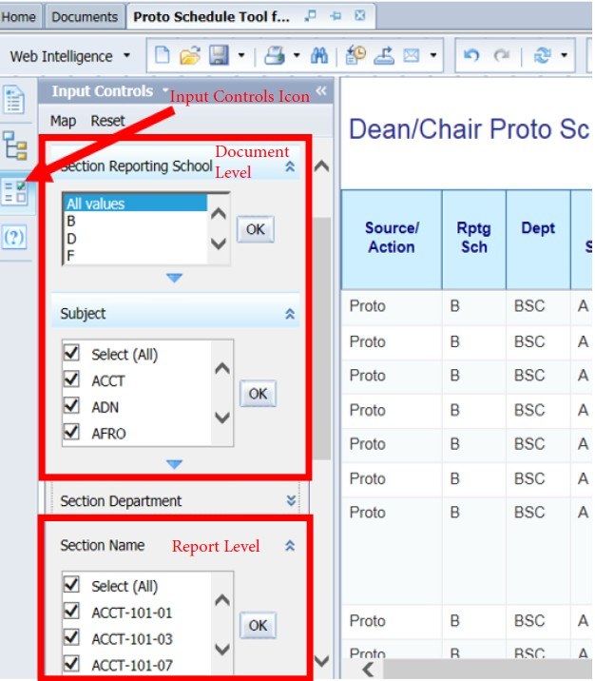
6. Then click on the Input Controls icon to open your selection filters. These contain document-level grouped filters, meaning, selections in one area modify the available selections in the other filters and the effect of the filter is felt throughout the document. You can choose by reporting school code, section subject, or the department associated with that section and then clicking the “OK” buttons. As each filter selection is made, the data table will change to show the effects – and you end up with your own Proto Schedule.
7. You can choose multiple selections in a single filter box by checking (clicking) each checkbox.
8. Below the grouped filters are additional filters for choosing by section name, section current status, primary flag and the length check validation.
9. Once you have filtered the overall
Proto down to your school’s schedule, you can study it for necessary changes: cancellations, modifications, and additions. There is a separate tab for each of these actions

Slide 17
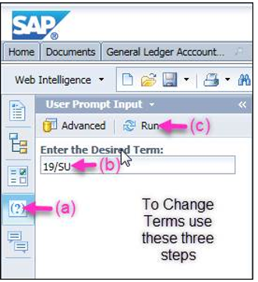
10. When updating the terms (Spring to Summer) take the following steps:
                Click on the icon at the upper left of the screen that looks like this (?).
                Overwrite the “19/SP” with “19/SU”
                Then click the blue double arrow “Refresh” Icon just above the term entry box.

Slide 18
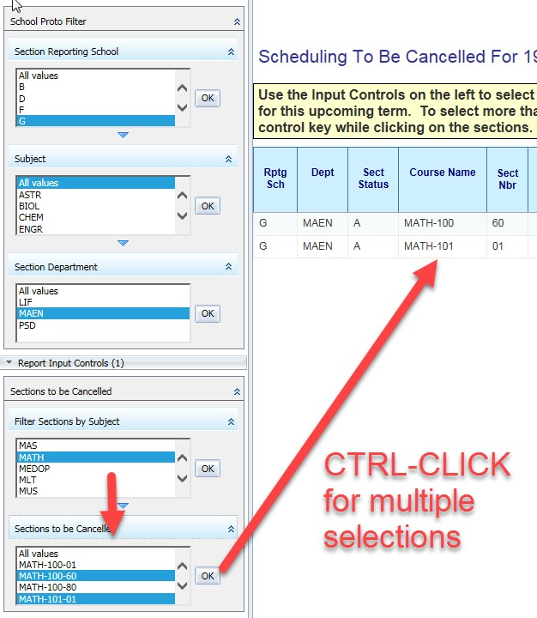
11. To Cancel Sections: click on the “To Be Cancelled” tab at the bottom of the page.
  The page opens up with pre- filtered copy of your PROTO report and the same grouped filters. The easiest way to choose sections for cancellation is to select them from the “Sections to be Cancelled” filter group.
  Now you can use the “Filter Sections by Subject” pulldown filter to limit the sections shown to a given set of subjects.
  Again, you can select multiple sections for cancellation by using the Control-click method.
  Once you have selected your sections to be cancelled, you need to enter the type of cancellation in the first column of the page:

Slide 19
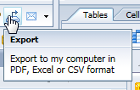
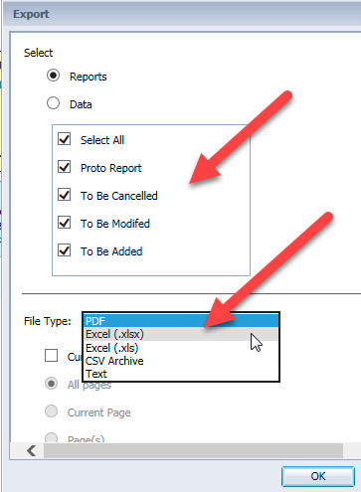
12. To Modify Sections: click on the “To Be Modifed” tab at the bottom of the page.
  Again you start with your modified Proto schedule and you have the grouped section filters, this time called “Sections to be Modified.” Select the sections you need to modify in the same way you choose sections to cancel.
  YOU WILL NOT MODIFY THE DATA HERE – THAT IS DONE IN EXCEL – HERE YOU ONLY
CHOOSE THE SECTIONS YOU NEED TO MODIFY.
13. To Add Sections: merely include the “To Be Added” tab in your output. It provides a blank Excel form for adding any sections you need.
14. Once you have entered your sections for cancellation and modification, click on the Export icon in the upper left to download your Excel workbook.
  You can leave the default of choosing all pages or just select the pages you need by clicking the appropriate boxes.
  Choose the file type of Excel (xlsx) and follow the download directions that appear on your screen from your browser.
  Save the file on your local machine. Then open in Excel.

Slide 20
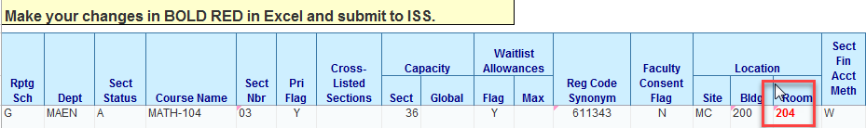
15. Close Business Objects.
16. In Excel:
  Open the workbook and you will see each of the tabs you selected for download. If you kept the defaults there are tabs containing: (1) Your School’s Proto Schedule, (2) To Be Cancelled, (3) To Be Modified, and (4) To Be Added.
  Proto. Has your current schedule – no changes needed on this page. Info only.
  To Be Cancelled. Confirm your selection of sections for cancellation. No other changes needed.
  To Be Modified. Make the changes to the selected sections. Use BOLD and RED text in Excel to highlight your changes. Save your workbook.
  To Be Added. This tab has the Proto headers you are used to. Enter in the new sections as needed. This can be in the default color and text. Validate the data and save your workbook.
  Once you confirm your changes. Save the workbook.

Slide 21
17. In OutLook:
  Attach a copy of the workbook to an email and submit to your approvers.
  Once approved, forward to ISS for data entry.
  ISS should acknowledge receipt.
18. Validation of Changes. BusinessObjects takes 24 hours to update changes once they have been made by ISS. You can open the Proto report whenever you wish after that to confirm that the changes you requested were actually made.
Any suggestions for validation logic are appreciated.

Slide 22
School & Department
Abbreviation for the School and Department offering the course:
[B] Arts, Communication and Social Sciences
[I] Language, Literature and Humanities
[G] Mathematics, Science, and Engineering
[O] Business Technology
[F] Wellness, Exercise Science and Athletics
[R] Counseling and Student Support Services
[D] Higher Education Center, National City
[U] Higher Education Center, Otay Mesa
[P] Higher Education Center, San Ysidro
[J] Continuing Education
[T] Academic Affairs/Instructional Support Services

Slide 23
Questions?
Walk-in Hours: MWF 3:00pm-4:00pm
Bldg. L103; ext. 6340

Slide 24
Thank You!

