Slide 1
Faculty Section Assignment (FASC)
AN Overview
Provided by:
Instructional Support Services Mia McClellan, Dean Brian Ebalo, Supervisor Percival Concha, ISS Specialist Institutional Technology Michael Davis, Director, Institutional Technology Bob Stretch, Senior Programmer Analyst
Human Resources Efren Barrera, Human Resources Business Systems Analyst

Slide 2
Agenda
Training: Purpose & Outcome
Schools and Centers: Responsibilities
Process Overview: FASC fields
Questions

Slide 3
Training: Purpose & Outcome
Purpose:
To review the responsibilities and process of Faculty Assignment with School/Center Deans and/or administrative staff.
Outcome:
To understand the elements which are needed to complete a Faculty Assignment
To be familiar with the Faculty Assignment (FASC) fields and how to accurately complete the process.

Slide 4
Schools & Center Responsibilities
Dean
Identify faculty to be assigned to each course section.
Plan and manage course sections and establish proper faculty assignment information.
Work with Administrative staff to ensure proper class Start/End dates.
Administrative Staff
Work with Dean to verify the accuracy of the faculty assignment and complete FASC fields.
Enter faculty names in FASC (verify section meeting information).

Slide 5
Process Overview
FASC fields

Slide 6
Assign Faculty Member
Look up faculty member(s) using either faculty ID or last name/ first name or first initial
ACTION: Enter the faculty member(s) to be assigned to the course section

Slide 7
Enter TERM Start/End Dates
Meeting information including Start/End dates entered in section offerings screen (SOFF), WILL automatically carry over into the FASC screen.
ACTION: Certify that faculty member’s proposed Start/End dates of the teaching assignment.

Slide 8
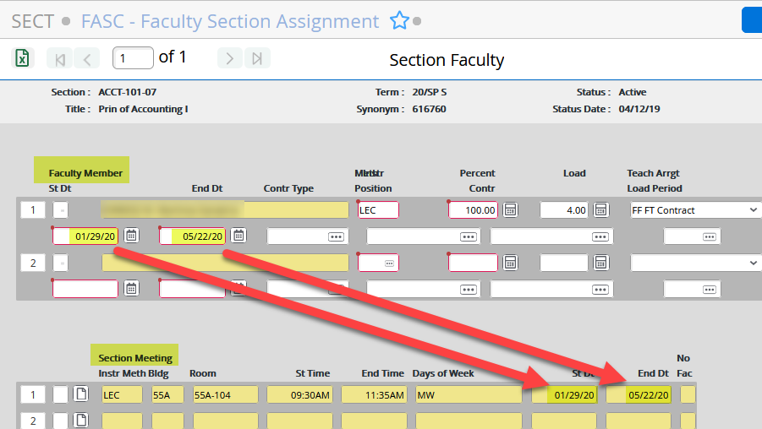
It is the responsibility of the School’s Administrative staff to certify the Start/End dates are current and accurate. NOTE: Any ‘Change’ to Start/End dates throughout any Phase in the schedule production process will require Admin staff to manually update the Start/End dates in the FASC

Slide 9
Instructional Method Position
Enter the faculty member(s) Instructional Method Position type(s):
ACTION: Select the instructional method type the faculty member will use to teach the course section.

Slide 10
Faculty Instructional Method Position Types
The following table shows the various method position types (and their descriptions) that you may select for both FT and PT faculty
Instructional Method | Description | Usage
LEC | Lecture Regular Load | To be applied to regular Load
LAB | Laboratory Regular Load | To be applied to regular Load

Slide 11
Additional Instructional Method Position Types for Contracted Faculty only

Slide 12
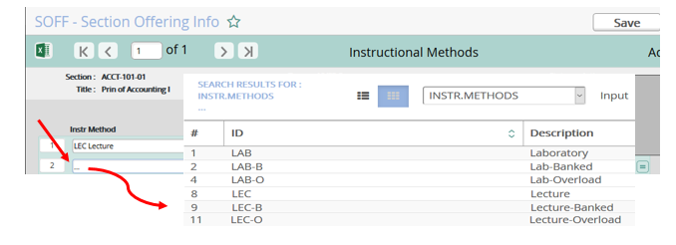
Entering NEW Method Position Types
1. GO INTO ‘SOFF’ screen
2. Enter ellipsis ‘…’ on the next available instructional method line, and Click ‘Save’
3. Select instruction method
4. Click ‘Save’ and ‘Exit’

Slide 13
Percent Control
Percent Control is used to calculate the exact workload for each faculty member.
ACTION: No action required – Please do not change.

Slide 14
Whether you assign a class to a single faculty member or multiple faculty (by default) each faculty member(s) assume 100% assignment for instruction in the section.
NOTE: If more than one faculty member is assigned to a section, the Load (not the Percent Contr) is adjusted.

Slide 15
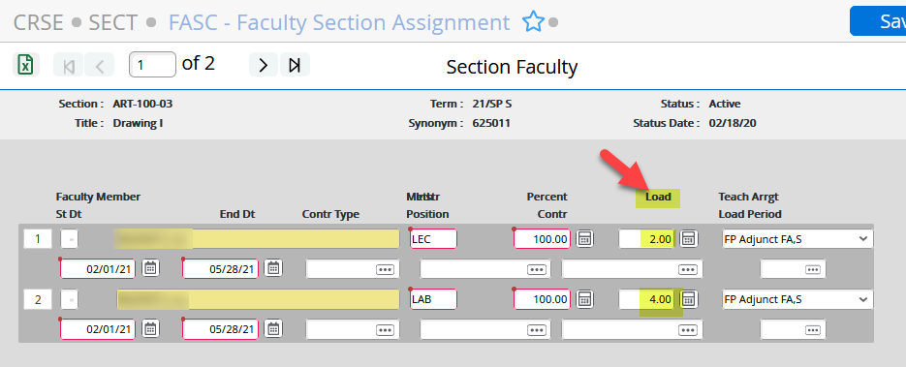
Load
The Load is the faculty member’s workload for the instructional method(s). Generally, a section can have up to 2 instructional methods with 2 separate loads.
Whether a ‘single’ faculty member or ‘multiple’ faculty members are assigned to a single section it cannot exceed the total units (or Load) of the course.

Slide 16
Examples of Managing Load
Scenario 1: Single faculty member assigned to a course with 4.0 Load:
Scenario 2: Multiple faculty members assigned to same course with 4.0 Load:

Slide 17
Teaching Arrangement
This field defines the teaching arrangement for the faculty member’s load.
ACTION: Assign (enter) the appropriate teaching arrangement code for the teaching faculty member’s teaching arrangement.

Slide 18
Types of teaching arrangements – Full-Time Faculty
The following are Teaching Arrangement Load types and descriptions for Full-time faculty:
Teach Arrangement Codes | Teach Arrangement Descriptions
FF | Full-Time Contract
FO | Overload, Full-Time (Receive Payment
XO | Overload Full-Time (Receive payment by timesheet
FL | Banking - Full-Time (Place in bank)
XX | No Load, No Pay, Cross-Listed

Slide 19
Types of teaching arrangements - ADJUNCT FACULTY
The following are Teaching Arrangement Load types and descriptions for Adjunct faculty:
Teach Arrangement Codes | Teach Arrangement Descriptions
FP | Adjunct Fall (FA), Spring (SP), (Receive payment by agreement)
XP | Adjunct Fall (FA), Spring (SP) (Receive payment by timesheet)
FI | Adjunct Summer (SU), (Receive payment by timesheet)
XI | Adjunct Summer (SU), (Receive payment by timesheet)
XX | No Load No Pay, Cross-Listed

Slide 20
Faculty Workload Reports: FWKL FWLR screens
The current faculty workload report (XFLR) is to be replaced by its original screen FWLR.
The use of the FWLR screen (same as XFLR) is to generate a listing of faculty members' active assignments (both instructional and non- instructional) for a specified date range. The report includes the total load for the instructor, but it does not provide any overload or underload conditions. Please refer to BOBJ report on validating Faculty Auditing including Overload.
In addition, the use of the Faculty Workload (FWKL) screen is to view the instructional and non-instructional workload for a faculty member. The FWKL screen is used to monitor and validate faculty workload to ensure FT faculty do not exceed 21.0 LHE for a given term. Note that any faculty member excessing 21.0 LHE for a given term needs VPPA approval.

Slide 21
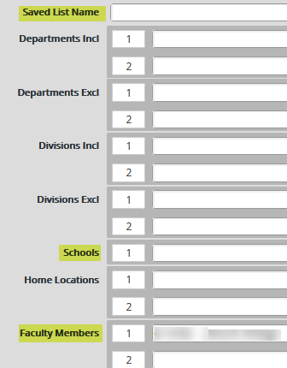
Faculty Workload Reports using Faculty Workload (FWLR) screen
Enter Start/End Dates:
You can either run load sheets by:
1. Save List Name
2. School
3. Faculty Member(s)
4. Click Save, then Update
5. Type ‘H’ for Hold, then Save,
then update

Slide 22
Workload Sample Report (FWLR)

Slide 23
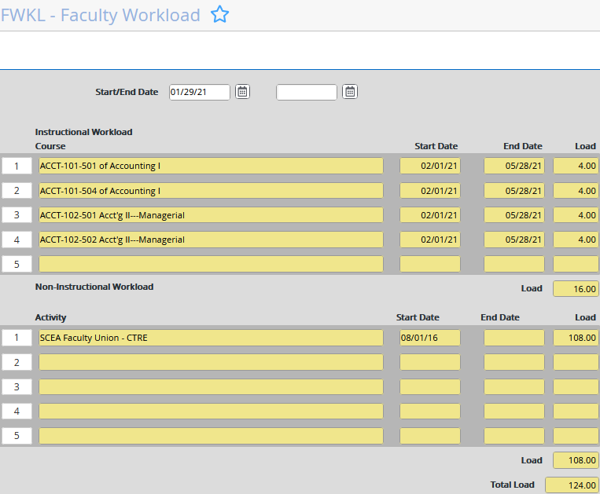
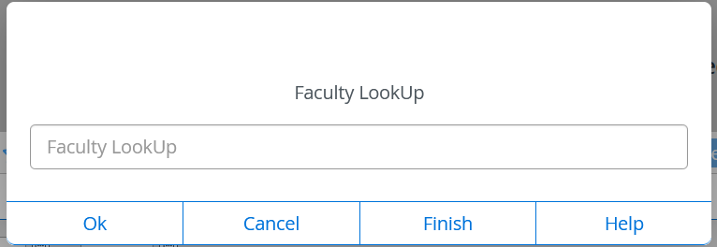
Faculty Workload (FWKL) screen
When you first enter into the FWKL screen, you are prompted to enter the faculty member and a date for your search. This screen displays workload data for the range of dates you specify.

Slide 24
Reminder!
NOTE: these teaching arrangement codes are both critical for faculty hour accounting and subject to frequent change over the term.
Current and correct Teaching Arrangement coding ensures accurate workload reports like FWKL, FWLR, HR Faculty Contracts, and accurate Faculty Hours Auditing BOBJ reports.

Slide 25
Timeout for Review
Faculty Member: Enter the faculty member(s) to be assigned to the course section
TERM Start/End Dates: Certify the faculty member’s proposed Start/End dates of the teaching assignment.
Instructional Method Position: Select the instructional method type the faculty member will use to teach the course section.
Percent Control: If more than one faculty member is assigned to a section, the Load (not the Percent Contr) is adjusted.
Teaching Arrangement: Assign (enter) the appropriate teaching arrangement code for the faculty member’s teaching arrangement.

Slide 26
Additional (NEW) FASC fields required for MIS reporting:
The following three additional FASC fields highlighted below have been identified as required MIS elements: A) Contract Type; B) Position; and C) Load Period.

Slide 27
Enter the type of contract for this faculty assignment: FACF for FT Faculty; OVERLOAD for Overload and/or Banked (for FT Faculty); FACP for PT Faculty:
A. Contract Type:
If you do not see the appropriate contract type in the faculty member’s selection of contract types, please contact HR to assist/add contract type.
Contract Type ID | Teaching Arrangements
FACF | FF
OVERLOAD | FO, XO, and FL
FACP | FP, XP, FC , and XC

Slide 28
To find the ‘available’ FT/PT faculty contract positions associated with your faculty member, type ellipsis (…)
Types of Positions
Select "y" when the pop-up asks “Select from all current positions for your faculty member? (Y/N)."

Slide 29
B. Position
Enter the faculty member's position.
For Full-Time Faculty there are 2 positions to choose from: 10 Mo FT Faculty (for Instructional Positions, or 11 Mo FT Faculty (for Non-Instructional Faculty.

Slide 30
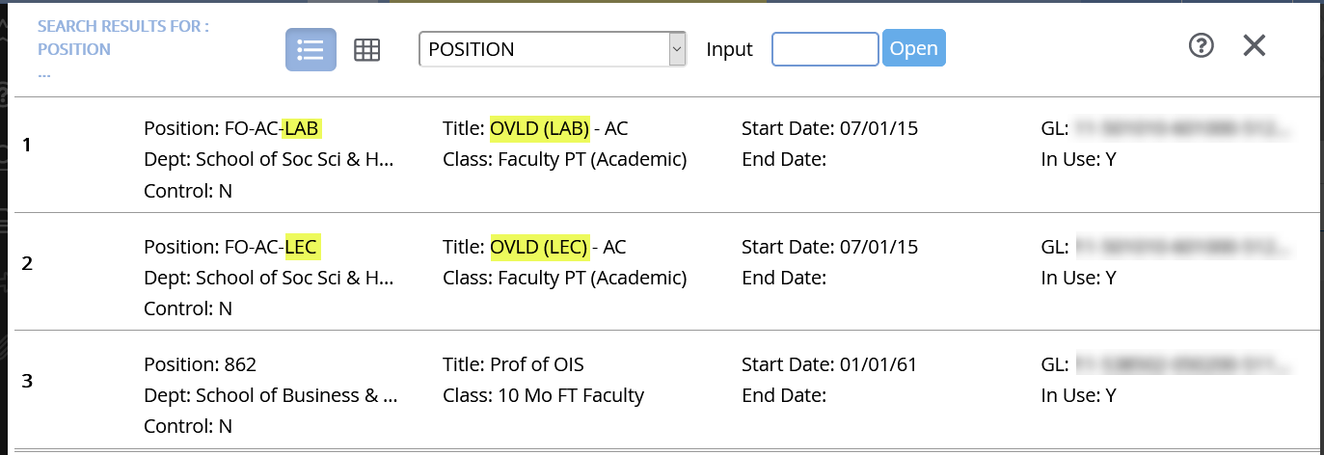
Select the appropriate position type based on Instructional Method (LEC and/or LAB) and Position Classification (FT or PT):
If you do not see the appropriate FT/PT position in the faculty member’s selection of contract positions, please contact HR to assist/add contract position.

Slide 31
C. Load Period
Certify that the appropriate load period for this faculty assignment.
The ‘Load Period’ is the ‘Reporting Term’ in which the faculty member’s assignment is active. The Load Period should align with the course sections’ reporting term.

Slide 32
To find the available Load Periods, simply type ellipsis (…) and select the appropriate Load Period for your faculty member:
Access available Load Periods

Slide 33
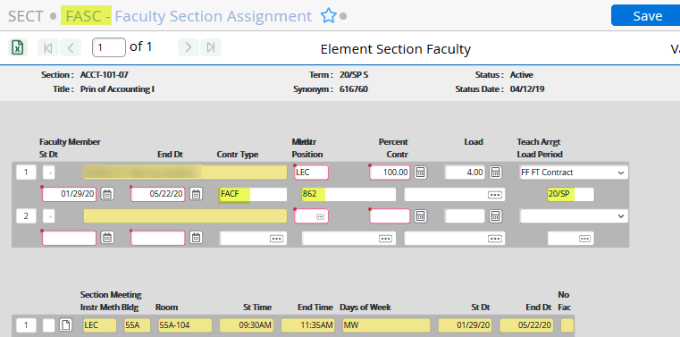
The following example above of a completed faculty section assignment entered in FASC screen.
Example of a Completed Faculty Section Assignment

Slide 34
Timeout for Review
Control Type: Enter the type of contract for this faculty assignment: FACF for FT Faculty; FACP for PT Faculty; OVERLOAD for Overload
Position: For Full-time Faculty there are (2) contract positions to choose from: 10 Mo FT Full-Time Faculty (Instructional) or 11 Mo FT Full-Time Faculty (Non-Instructional)
Load Period: Certify that the appropriate load period for this faculty assignment.

Slide 35
Questions?

