Slide 1
Workshop #2: Business Objects Reports on Faculty Auditing
Provided by:
Brian Ebalo, Academic Services Supervisor
Bob Stretch, Senior Programmer Analyst
Efren Barrera, Human Resources Business Systems Analyst

Slide 2
Agenda
1. Purpose & Outcome
2. Finding Resources
3. Business Objects (BOBJ) Faculty Auditing Reports
4. Reporting Errors using the Faculty Auditing Inquiry form
5. Questions

Slide 3
1. Purpose & Outcome
Training will provide you instruction on where and how to access faculty auditing BOBJ reports.
With faculty auditing reports you will have the capability to:
Generate faculty assignments up to a school-level to help you organize faculty assignments.
Validate the inputting data and
Assist faculty with inquiries regarding workload and teaching arrangements.

Slide 4
Key Terms
Assigned Role or ‘Role’
AY or ‘Academic Year’
Bank LHE (FL)
Campus Organization Name
Contract Reassign LHE
Excess Period Load
Instructional Method
Load
Non-contract Reassign LHE
OL LHE (FO)
Period Load or ‘Period’
Reassignment Organization
Reassignment Type
Reg LHE (FF)
Reporting Year
Rpt School
Section Name (Primary) or ‘Section (Primary)
Teaching Arrangement
Term
Term Total Load Vol LHE (FV)
Xlist LHE (XX) Year

Slide 5
2. Finding Resources: BOBJ Faculty Auditing Reports - MySWC – Logging into BOBJ
Log into your MySWC account, Click Campus Apps, Click on BusinessObjects icon

Slide 6
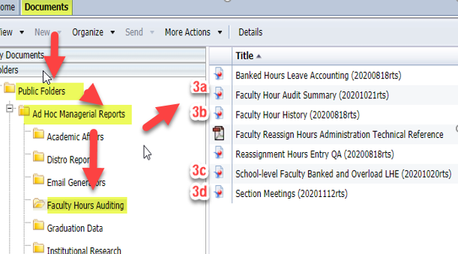
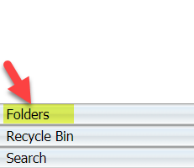
Finding Resources: BOBJ Faculty Auditing Reports, BOBJ Homepage
The following is a pathway to access all faculty auditing BOBJ reports
Documents> Public Folders> Ad Hoc Managerial Reports> Faculty Hours Auditing
Note: your folders option maybe located at the bottom left of you screen depending on how you’re accessing your reports.

Slide 7
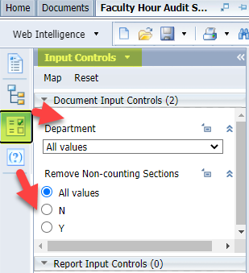
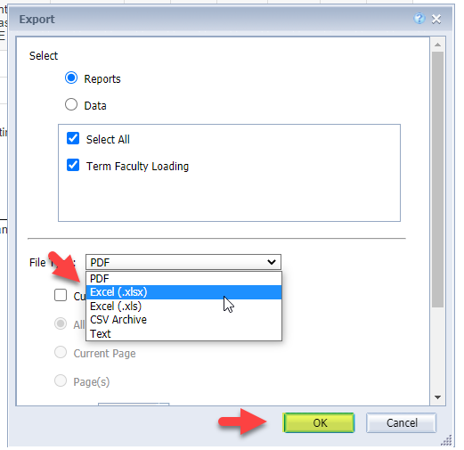
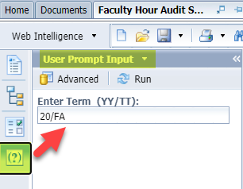
How to Run BOBJ Reports
To ensure you have the most current data in your BOBJ reports you must be familiar with following basic functions:
1. User Prompt Input Controls:
2. Input Controls:
3. Export:

Slide 8
3. Business Objects (BOBJ) Reports
3a. Faculty Hour Audit Summary
3b. Faculty Hour History
3c. School-level Faculty Banked and Overload LHE
3d. Section Meetings

Slide 9
3a. Faculty Hour Audit Summary Report
This report provides a list of full-time faculty for each reporting school with single-line summaries of teaching arrangement and reassignment LHE for each term. Each school appears on a separate page.

Slide 10
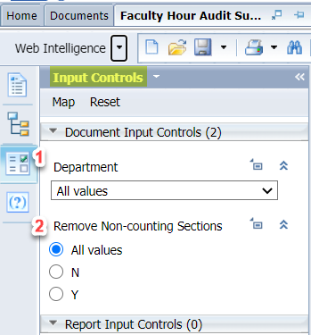
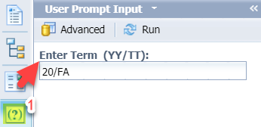
Faculty Hour Audit Summary: Run Report
Prompt Input #1: Enter Term (YY/TT)
Input Control #1:
Select your School/Center/Dept
Input Control #2:
Sort by:
All values (primary & secondary)
‘N’ or secondary only
‘Y’ or primary only

Slide 11
Faculty Hour Audit Summary Elements
ACTION: Validate Regular LHE (FF), Overload (FO) and Term Total Load columns. Note (for Term Total) underages are shaded in light gray and overages are shaded in dark gray. These irregularities should prompt the user to check for any missed contractual or non-contractual reassign time.

Slide 12
3b. Faculty Hour History Report
Report provides the historic summary of full-time faculty academic and non-academic assignments from 2010 to present.
Lists assigned sections, teaching arrangements, instructional methods along with campus organizations and roles for each term and year.

Slide 13
Faculty Hour History: Run Report
Input Control #1:
Select your School/Center/Dept
Input Control #2:
Select you Reporting Year
Input Control #3:
Select your faculty member by Faculty ID or Faculty Name
Input Control #4:
Sort by:
All values (primary & secondary)
‘N’ or secondary only
‘Y’ or primary only

Slide 14
Faculty Hour History Elements
ACTION: Validate Period Load and Teaching Arrangement columns. Verify 15 LHE per Term and and 30 LHE per Annual total

Slide 15
3c. School-level Faculty Banked and Overload LHE Report
Report provides school-level banked and overloaded LHE values from 2010 to date.
Can be filterable by year and teaching arrangement type
Includes a detail sheet with the individual sections listed that can be filtered by school and faculty member.

Slide 16
School-level Faculty Banked and Overload LHE: Run Report
Input Control #1:
Select Academic Year
Input Control #2:
Select Teaching Arrangement
Input Control #3:
Sort by:
Reporting School
Faculty Name
Faculty ID

Slide 17
School-level Faculty Banked and Overload LHE Elements
Validate your faculty assignment (FASC) entries including Teaching Arrangement, Load, and Instructional Method.

Slide 18
3d. Section Meetings Report
Provides the meeting times, dates and daysof all active sections for a selected term. Filterable by department. Can filter out individual faculty members by ID.

Slide 19
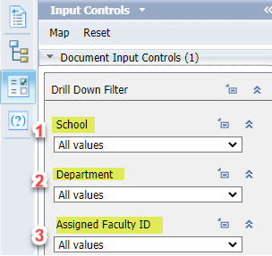
Section Meetings Report: Run Report
Prompt Input #1: Enter Term (YY/TT)
Input Control #1:
Select your School
Input Control #2:
Select your Department
Input Control #3:
Assign Faculty ID

Slide 20
Section Meeting Elements
Validate all course section meeting information including Section Number (500-599 for online; 600-699 for Hybrid; all other for REM), All Assigned Faculty, Start Date, End Date and Days.
NOTE: All Courses coded ‘REM’ for remote location are greyed out and italicized.

Slide 21
4. Reporting inquires using the Faculty Auditing Inquiry form
Complete the Faculty Auditing Inquiry form including BOBJ Report(s), Category and detailed description.

Slide 22
CONTACTS
Mia McClellan, Dean, Instructional Support Services
mmcclellan@swccd.edu
Brian Ebalo, Academic Services Supervisor
bebalo@swccd.edu
Instructional Support Services Specialist
pconcha@swccd.edu
Efren Barrera, Human Resources Business Systems Analyst, Human Resources ebarrera@swccd.edu
Bob Stretch, Senior Programmer Analyst, Institutional Technology
bstretch@swccd.edu

Slide 23
5. Questions?

