Slide 1
Institutional Program Review (PR) Training: Comprehensive
Dr. Tanya Haddad, Professor & Academic Senate Vice President
Anna Flores, Research & Planning Coordinator
Briana Todhunter, Principal Research Analyst
Office of Institutional Research & Planning

Slide 2

Our Objectives
Communicate the Timeline for Completion
Discuss the Purpose of Program Review
Provide Data Sources
PR Application Training

Slide 3

Program Review Process
Program Review is Required Every Year
Every 4 Years a “Comprehensive” Review is completed
In the year that a Comprehensive Review is not completed, an “Annual Update” is completed
Validated for completeness and quality
How do I know if I am completing Annual update or Comprehensive? See SWC Program Review webpage

Slide 4

What’s the Point of PR?
Academic & Administrative program reviews are intended to strengthen and redirect programs
Examples Include Providing:
  Successful arguments for new faculty positions
  Program development
    Combining closely related majors
    Creating new majors
  New equipment to improve learning or service quality
Analyze student learning outcome (SLO) results & Required for Accreditation

Slide 5
Comprehensive - Section 5
Mission, Planning, and Student Success:
  How program goals align with the overall mission of the district. Include dialogue on diversity, equity, and inclusion.
  Course Success and Completion using 4-5 years of data to determine trends and/or conclusions. Identify equity gaps using data disaggregated by race/ethnicity and other relevant characteristics.
  Identify any Programs for Discontinuance by analyzing 4-5 years of success and completion data and enrollment trends. Provide comprehensive information on the viability, suspension, and discontinuance considerations.

Slide 6
Comprehensive - Section 5
Student Learning Outcomes (SLOs)
  Describe major findings based on review of disaggregated program and/or course student learning outcome data and describe any planned or implemented program improvements.
Changing Conditions in the Field
  Provide data collected to determine program modifications that respond to changing conditions in the field.
Staffing & Facility Resource Sufficiency
  Sources of evidence provided for staffing needed (ex: Faculty Hiring Prioritization (FHP) list or data from Business Objects)
  Sources of evidence provided for facilities/equipment (ex: Facilities Master Plan).
Professional Development Activities (Optional)

Slide 7
Comprehensive – Section 3 & 4
Section 3: List of all Degrees/Certificates
  Title & Major code
  # of students declared in major code
  # of students who completed the program in the last 5 years (cumulative)
Section 4: Course Review for Recency and Articulation
  Course Title & Number from Catalog
  Last Date of activation, modification, or inactivation
  Year for next review, modification, or inactivation
  Degrees/Course Activation -> Curricunet
  # of Students -> Shared Data file or Business Objects

Slide 8
Data Resources
Google Drive with data from Business Objects & eLumen
  Performance data from Business Objects (enrollment, course completion and success, program awards)
  Program SLO Data from eLumen
  Check Google Drive through ‘G Suite Apps’ or click on link from e-mail
*Research Dashboards*
  https://www.swccd.edu/administration/institutional-research-and-planning/data-dashboards.aspx
  Datamart
  https://datamart.cccco.edu/datamart.aspx
Student Success Metrics (SSM) Dashboard
  https://www.calpassplus.org/LaunchBoard/Student-Success-Metrics.aspx
ISLO/GESLO Reports
  https://www.swccd.edu/administration/institutional-research-and-planning/student-learning-outcomes-slo/_files/2021-islo-geslo-report.pdf
  PSLO reports also available from SLO Liaisons

Slide 9

Program Review Outcomes
Colleagues Examine their Programs and make Goals for improvements/innovations
Use Institutional Goals to align with Program Goals
Goal-Setting connects improvements to Measurable Actions/Outcomes
Program Review is tied to strategic resource allocation

Slide 10
Program Review Goal-Setting
Section 1: Goals/Activities
  Goals: Create or modify existing ones
    Describe the goal set to improve the program’s effectiveness and quality, while connecting to an overall institutional goal
  Activity: Create or modify how to accomplish your goal
    Use research data, SLO/PSLO data, studies, or analysis to justify how the activity will accomplish the goal
  Determine how your activity will be assessed
Section 2: Request resources if needed for your goal
  Resource requests require a rationale that clearly demonstrates how the resource is needed to reach the associated goal and describes the expected outcome/improvement of acquiring the resource
  Incorporating data to support the rationale is preferred
  Cost estimates must be included in a resource request (ex: PDF copies of written quote, online cart, or other documentation).

Slide 11
Goal & Activity Example (Actual)
Goal: Redesign classrooms to eliminate equity gaps
Activity: By Fall 2023 create 360-degree whiteboard classrooms
Activity Explanation/Justification: A review of the 2022 PSLO data shows performance gaps in Black or African American, Hispanic, Asian, and Two or more races. These categories indicate an overall “low to no proficiency” ranging from 20-43%. These performance gaps show inequity within the classroom. These equity gaps can be closed by creating 360-degree whiteboard classrooms, allowing for more student interactions with the instructor being the “guide on the side” instead of the “sage on the stage” in the front of the class. Studies of classrooms which allow students to work in groups on the vertical wall surfaces show increase in equitable practices, students participating more equitably within the classroom, increased student interaction with the course material and more student discussion.
Activity Assessment: This activity will be assessed in the Spring of 2024 through collection and study of changes in equity gaps with PSLO data.

Slide 12
Resource Request Example
Resource Rationale: A review of the 2022 PSLO data shows performance gaps in Black or African American, Hispanic, Asian, and Two or more races. These categories indicate an overall “low to no proficiency” ranging from 20-43%. In a study on work surfaces’ impact on math learning, Liljedahl found whiteboards promoted better engagement & math thinking than the use of paper & pencil. His research documented the following about student behaviors using whiteboards: Students are more eager to start the task and began discussing and writing sooner, they are more likely to participate, discuss, and interact to transfer knowledge, and students are more likely to persist through challenges. Because written work shows non-linearity that reflects the thinking process and because it is easy to erase, students are willing to take risks & errors are not a big deal...
  Source: https://accelerationproject.org/Blog/360-degree-whiteboards-an-equity-strategy-to-improve-outcomes-in-precalculus.
Cost: $25,500 (Cost Estimate Attached)
Note: This is an actual Program Review submitted and funded in 2022.

Slide 13
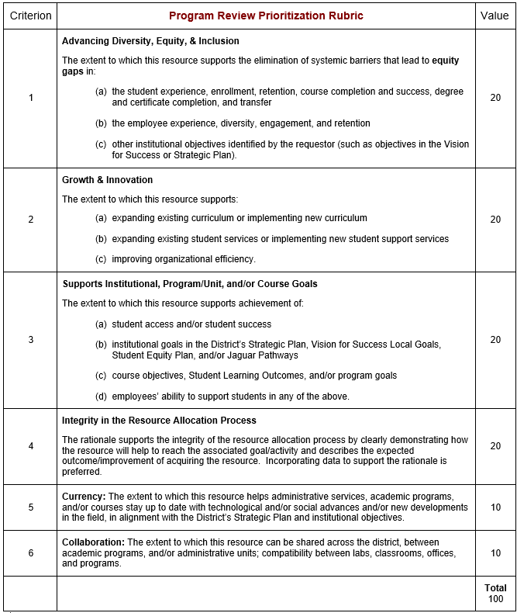

Slide 14
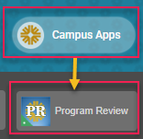
Program Review App
Located in: My SWC – > Campus Apps

Slide 15

Thank you!
Contact Anna Flores
Email: aflores@swccd.edu
Phone: 619-216-6615

